Slide 1
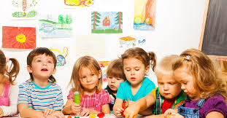
Readiness
Children Readiness for Preschool

Slide 2
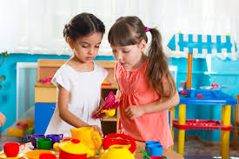
What is readiness?
Ready to make a successful and smooth transition into a school
Can be achieved by planning ahead of children’s activities
The children should actively participate in skill-building activities.
Readiness entails a much broader range of skills
Requires self-care
Notes:
The preparedness to make a successful and smooth transition into a school is referred to as children’s redness. Readiness is attained through planning children's activities early in advance and preparing them physiologically for school. The children must also play their role by actively participating in skill-building activities. Notably, readiness among children does require not only academic concentration but also a much broader range of skills. Children who are ready to join a preschool must have a sense of self-care, whereby they can handle their dishes and toileting needs.

Slide 3
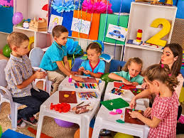
Importance of children's readiness
Allows teachers to shape children’s skills further
Children can easily catch up with plays of their peers
A key factor for social interaction
Triggers children to advance quickly in academic wise
Notes:
Readiness among children is a vital tool for academic success. According to Bell, Bayliss, Glauert & Ohan, (2018), preparation makes work for teachers less cumbersome, a situation that assists in shaping children's skills further. It is easier for a prepared child to plays with peers as opposed to unprepared ones. Bayliss, Glauert & Ohan, (2018) also advise parents to prepare their child for school, hence boosting their social interactions. Importantly, preparedness triggers children positively by elevating their skills academically.

Slide 4
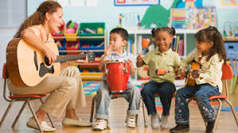
Importance of children's readiness
Improvement in listening skills
Improvement in reading skills
Comfortable in adhering to instruction
Developed art of asking questions
Notes:
A teacher or parent needs to equip a child with the necessary information, which will be the central driver for improved listening skills. Listening skills will assist the child in capturing class notes. Brooks & Murray (2018) suggest that a well-prepared child stands a higher chance of possessing exceptional reading skills, thereby elevating success levels. Brooks & Murray (2018) opine that parents who advocate for getting their children ready for preschool experiences minimal challenges when it comes to following instructions. Again, such children have a high tendency to ask questions, which is among the critical tools for learning.

Slide 5
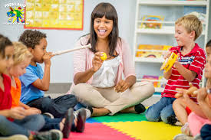
Critical features of a preschool
Well-trained children’s teachers
Modified and decorated fields for children to play
Presence of book for literature learning
A preschool should collaborate with children's parents
Notes:
A preschool which is intending to get children ready for school should modify and decorated fields for playing purposes. Again, it should have Well-trained children’s teachers who will aid in providing child-centered education. Bates (2019) suggested that a preschool intending to prepare a child for a learning environment should have graphic related books that the appropriate literature (Bates, 2019). Importantly, a preschool should collaborate with children’s parents to ensure that they have access to necessary assistance.

Slide 6
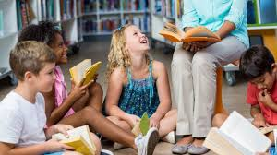
Critical features of a preschool
provision of visual strategies/visual aids
Plans for outings
Top-notch security strategies
Attractive classes
Notes:
A school with child preparedness motive should put in place visual strategies or aids purposely to boost learner's understanding. Visual aids stand as among learning tools that provide children with a more involving learning method. Again, these schools should have strategies where children can move out of school to explore further, for instance, in areas like zoos. Warren, Daraganova & O’Connor (2018) enlightened that children's preschools should take a keynote when it comes to putting in place security measures. Children's security must be emphasized, and the school's management should make classrooms as much attractive as possible to boost learning.

Slide 7
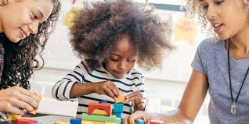
Essential skills for a child
Self-regulation
Sensory processing
Receptive language
Expressive language
Articulation
Notes:
Self-regulation will be a crucial skill for a child who is planning to enroll in kindergarten school. This skill entails the ability to change, maintain, and obtain the emotions and behavior necessary for a particular task (Bates, 2019). The second skill is sensory processing, which demands the child to process neural simulations that will influence learning and attention. Being well versed with receptive language is a crucial skill among the children since it boosts comprehension of spoken language. Bates (2019) highlights expressive language to be another vital skill for children, as it aids them in communicating their needs appropriately. In addition to language expression, the child should learn how to articulate words exceptionally to avoid misunderstanding.

Slide 8
References
Bell, M. F., Bayliss, D. M., Glauert, R., & Ohan, J. L. (2018). School readiness of maltreated children: Associations of timing, type, and chronicity of maltreatment. Child abuse & neglect, 76, 426-439.
Brooks, E., & Murray, J. (2018). Ready, steady, learn: school readiness and children’s voices in English early childhood settings. Education 3-13, 46(2), 143-156.
Bates, A. (2019). Readiness for School, Time and Ethics in Educational Practice. Studies in Philosophy and Education, 38(4), 411-426.
Warren, D., Daraganova, G., & O’Connor, M. (2018) Preschool and children’s readiness for school. Growing Up In Australia, 73.

